Slide 1
Gamification SQA
Cameron Kozan, Ryan Ross, Zaid Al-Safi, Alex Navarre

Slide 2
Introduction - Scope and Intent of SQA activities
Our objective is to ensure that the product does not deviate far from the original gamification design specifications. If it is discovered that deviation has occurred, the team will notify each member to prevent future deviations and to correct the previous deviations. Also, the team will perform a walkthrough to analyze the product’s quality at any stage of development. Error detection and possible enhancements are also expressed to each team member.

Slide 3
Introduction - SQA organizational role
Our organizational role is to review the product at specific times during product implementation. Upon reviewing, the team member duties will be to evaluate the software at its current development stage and recognize any defects in the subsequent stage (design or implementation). The team will directly interact with the customer in group discussions, discussing any errors or possible enhancements that have been identified. In addition, the team will ensure that the customer has not deviated in any way from the initial design specifications.

Slide 4
Task Overview
What will we do? Each group member will have to periodically go through the website to perform reliability testing. Individual use should help our team find the smaller, potentially lower priority, errors early on. Performing periodic testing throughout the life of our project will help ensure we can mitigate problems closer to when they arise. Each member will be responsible for checking new functionality, along with existing functions.
What will come out of this? As a result, a short report will be written for our client meetings. The reports will cover issues found, their priority, and resolution. The reports will be collected in a defect log.

Slide 5
SQA Resources
Eclipse IDE – Java testing and development
Visual Studio Code – HTML testing and development
Visual Studio Community – C# testing and development
AWS RDS – database development and testing
Microsoft Azure – database development and testing
Figma – page design mockups
Google Drive – collaborative document management
Test.AI - Automated Web testing
Selenium - Automated Web testing
Cypress.io - Automated Web testing

Slide 6
Standards, Practices and Conventions
Documentation Standards: Whenever applicable, documents will all follow the same format and layout. This layout was predetermined by our group before the project began.
Coding Standards: Standard AWS RDS naming conventions and format will be followed for the database. HTML5/CSS3 standards will be upheld for the website creation.
We will also be following both C# and Java best practices.

Slide 7
Review and Audits
The software will have scheduled reviews to detect any defects in the current prototype, and to determine any notable enhancements that should be implemented prior to the final product.
The Development leader will oversee any formal technical reviews. Any defects or enhancements will be discussed and recorded by the Development leader. Each defect or enhancement will be given a priority rank, which will be recorded.
Each member will be responsible for reviewing his own software module during module creation and upon module completion. Once each major software module is complete, it is the members duty to inform the Development leader that the module is ready for review.

Slide 8
Review and Audits
The RMMM review will focus on determining if the proposed risk management for the development of this software is within reason
The Requirements Specification review will work to analyze the proposed design of the software
The focus of this review will be to remove or discuss changes to any obvious design flaws
The Interface design review will be conducted first will team members responsible for the design, look and feel for the website
The test specification review will be used to review and analyze our four step test strategy
Backend, Frontend, Integration, and Regression testing

Slide 9
Problem Reporting and Corrective Action - Reporting
For all minor issues that occur in any FTR, that issue will be reported to every member on the team for feedback on how to fix the issue and proceed with the task at hand. If a large issue occurs the issue will be reported to all team members and the client in order to use all the resources available to fix the issue that arose.

Slide 10
Problem Reporting and Corrective Action - Responsibilities
The responsibility to contact the team will be the member that completes the FTR audit. At that point the team will decide if the issue is large enough to escalate the issue to the client. The team lead will send an email to inform the client of any important information at that point.

Slide 11
Problem Reporting and Corrective Action - Data collection
All error/defect data will be collected at the time it occurs whether the team member deems it necessary or not. The data will be stored in the review document if one exists or a document will be created to store the data along with any information about how the error occurred.

Slide 12
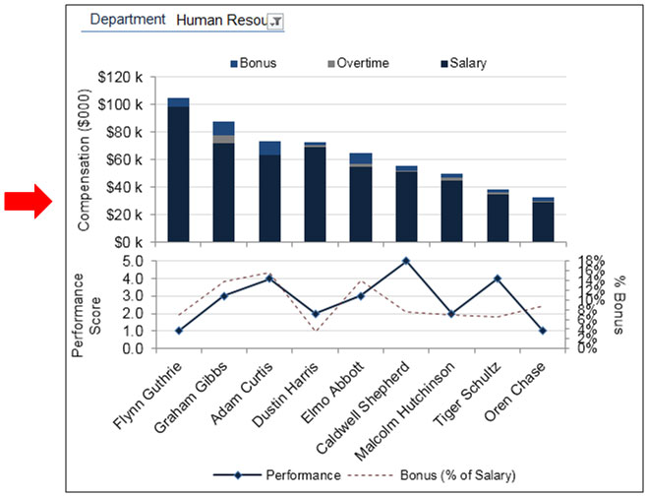
Problem Reporting and Corrective Action - Statistical SQA
If the error that occurs is recurring then a basic time series analysis will be performed to gain as much insight about the issue as possible. Bar charts may be used to show trends in the data.

Slide 13
Software Process Improvement Activities
The goals and objectives of the SPI are to lower the frequency of software defects and to determine the underlying cause of the defects that occur. Furthermore, once the underlying causes have been identified, measures will be taken to determine the best course of action to eliminate the problem.

Slide 14
Software Process Improvement Activities (cont.)
Based on the Statistical information gathered, the Development leader will keep a tally of what errors or causes of errors occur most frequently. The more often a defect occurs from the same underlying cause, the more problematic an area will be considered. Depending on the nature of the cause and the individuals involved, two actions can take place: (1) the Development leader will investigate the Statistical SQA information and the defect log to determine if the problem area exists primarily for a single developer, or (2) if every developer experiences the same problem.
If the problem occurs mostly from one user, the developer will be informed of the frequency of the personal problem area. Most often, the developer has a better idea of how to handle his own implementation oversights.
If the problem occurs from all developer, development practices will be analyzed to determine the cause of the problem. The problem and possible solutions will be examined at a meeting to all the developers.

Slide 15
Software Configuration Management Overview
We will be creating a baseline for each artifact to maintain version control and to be able to view what changes have been made, along with seeing whom was responsible for each of these changes. There will be a project roadmap which will have all of the dates to which each configuration item shall be delivered. These dates have been agreed upon by both the team and the clients. If the dates wish to be changed,it MUST be agreed upon by both the team and client. Last but not least, we will have code reviews to make sure that the code we write is complete, consistent and is well written. In order for a code review to be deemed completed, it must be signed off by all team members. In the event of a member not being present during a code review, the code review will either be pushed back to a further date, or the code review will continue as planned, and the absent member will be required to review the code on their own time, in a timely manner.

Slide 16
Software Configuration Management Overview - Approach
All documents required by the Prof. will be baselined. In the event of a change in the document, the previous text that shall be replaced will be highlighted to ensure that the team is able to differentiate the previous version to the new one. The person editing the document will be the person in charge of making this change.
The code will be stored within a repository, where the files will have revision history, along with having the contributor’s name. The code reviews will happen during team meetings and be reviewed from the repository.
During the planning stages of the project, we will devise a roadmap with our clients require a signature from both parties to ensure that the road map will not change unless both parties agree. As previously stated, both clients will need to sign off on a change of delivery.

Slide 17
Software Configuration Management Overview - Impact
There’s a wide variety of positive and negative impacts. Some of the positive impacts is that it will hold people accountable. As a team, we will be required to stick to the delivery dates. The clients will also be accountable to give us what they want well in advance. Code reviews allow us, again, to hold people accountable. From code reviews, we will also be able to seek out potential bugs in the software, determine if there are any bad practices that we can rewrite and make sure we’re on the same page of how the code works and are able to ask questions if we are unsure.
Some negative impacts of using this are that time is a big factor within this project. We only have 8 months to totally complete this project. Creating road maps, doing code reviews along with doing version control on artifacts all cost time, which is very limited for us.

Slide 18
SQA Tools, Techniques, Methods
We will be using a number of tools in order to make sure our software is at the highest level possible. Due to the nature of our project, we will be using web testing tools. Some of the tools we will be using include Selenium Web Driver, Cypress.io, and possibly Test.ai.
Along with testing during, we will be creating automated tests that allows us to make sure any of the effort we have done in the past is not broken due to changes in the code. On top of making sure our code stays at its peak we will also be doing a combination of white box and black box testing.
Before anyone submits code to the project, they will have completed white box testing during development and directly after completion of a task. Once the white box testing is completed, the same user will complete black box testing on the said piece of code, the programmer will make sure all of the automated tests work properly, along with creating new tests (if applicable)

Slide 19
Questions?

